Slide 1

Team
Fantastic Four
Presents
DIU Assist
Members
STC ASSIST
Acknowledgement

Slide 2

Team Members
Acknowledgement
STC ASSIST
Mr. Md. Jueal Mia
Senior Lecturer
Department of Computer Science and Engineering
Faculty of Science and Information Technology

Slide 3




01
02
03
04
Team Members
Acknowledgement
STC ASSIST
Md. Abdullah Ibna Harun Md Mahfuzur Rahman Mahade Hasan forhad Abidur Rahman Khan
ID : 193-15-13426 ID : 193-15-13416 ID: 193-15-13355 ID : 193-15-13374

Slide 4
CONTENT

Slide 5
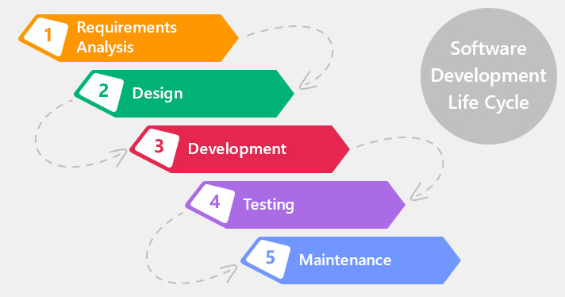
SDLC Waterfall Model

Slide 6
OBEJCTIVE
Make the application easier and reliable
Real time data entry
Handling database
Implementing browser
Data Security

Slide 7
Motivation
Object Oriented Programming concept implementation
Real life Project
Managing Students requirements for daily usages
Implementing graphical user interface using Swing
Gaining new experiences with this real life project

Slide 8
Requirements
Login
Quick Start
Students Information
Teachers Information
Easy Browser access

Slide 9

Analysis
Our analysis says that, there is DIU Smart Student App work on this kind of project.
But We have Some Special Features,
Real Time Browsing Experience
DIU Blended Learning Center
Teachers and Students Database
DIU Smart Student App

Slide 10
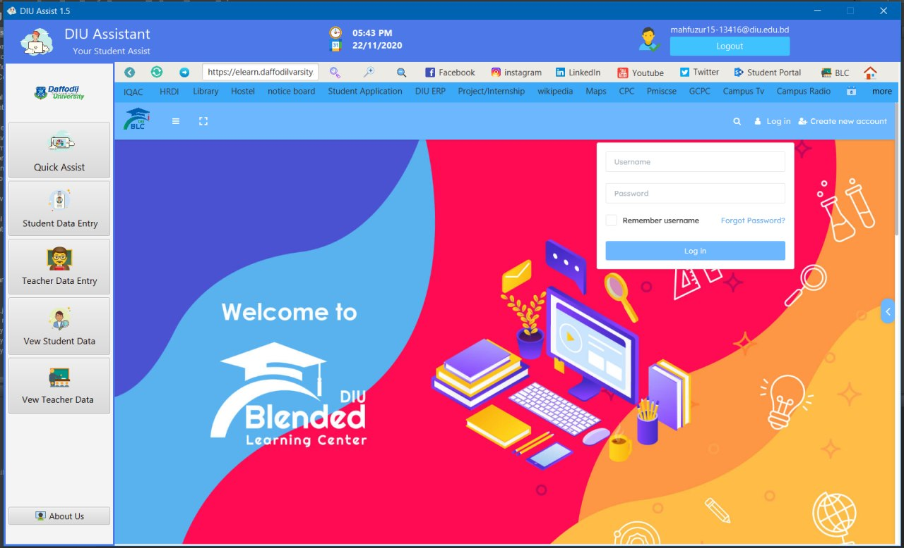
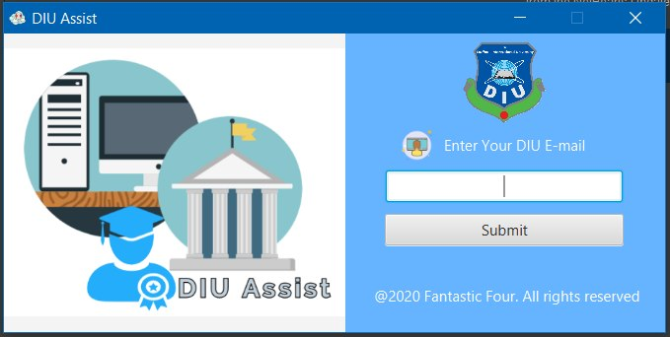
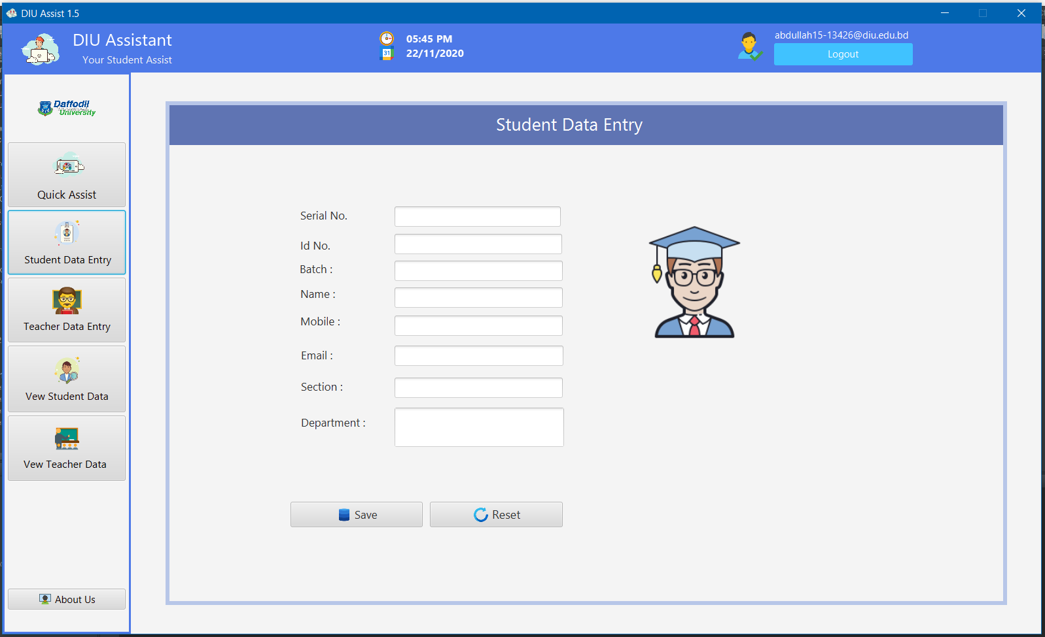
Demo
Title Screen Log in Operational features

Slide 11
Implemented Software
IDE: Netbeans (1.8)
Database Management System : MySQL (XAMPP 7.4.12)
Libraries :
MySQL JDBC Driver.
Jfoinex 8.0.jar
Fontawsomfx 8.2.jar
Java DB Driver.

Slide 12
Challenges
Faced error connecting into Database
Error in showing data from database in tableview
Not getting any data from user input
Problem in insert, modify, delete, view from database
Some Little bugs fixed
Exception handling

Slide 13
Upcoming Features
• Dynamic Search from Database
• Relational DBMS
• Routine and Event's management
• Move into Web and Android Application

Slide 14
Upcoming Features
Any
Questions?
Real time searching from database
Relational database management system
Upgrade into Web and Android Application

Slide 15
Upcoming Features
Real time searching from database
Relational database management system
Upgrade into Web and Android Application
Thanks You So Much!

